Slide 1
Advanced Modeling for Distribution Planning with OpenDSS
Instructor
Roger C. Dugan Sr. Technical Executive Sacramento, California June 22-23, 2017

Slide 2

Instructor
Roger C. Dugan, Life Fellow, IEEE
Roger is a Sr. Technical Executive with EPRI in Knoxville, Tennessee USA. He has over 45 years of combined experience in distribution engineering with EPRI, Electrotek Concepts, and Cooper Power Systems. He holds the BSEE degree from Ohio University and the Master of Engineering in Electric Power Engineering degree from Rensselaer Polytechnic Institute, Troy, NY. Roger has worked on many diverse aspects of power engineering over his career because of his interests in applying computer methods to power system simulation. Beginning with a student internship with Columbus and Southern Ohio Electric Co, his work has been focused on Distribution Engineering. He was elected a Fellow of the IEEE for his contributions in harmonics and transients analysis. Recently, he has been very active in distributed generation, particularly as it applies to utility distribution systems and distribution system analysis. He was the 2005 recipient of the IEEE Excellence in Distribution Engineering Award. He is coauthor of Electrical Power Systems Quality published by McGraw-Hill, now in its 3rd edition. He serves on the IEEE PES Distribution System Analysis Subcommittee and is active in the Distribution Test Feeders WG.

Slide 3
Transformer Modeling

Slide 4
Per Units or Actual values?
Distribution system analysis is more commonly done using actual volts, amps, ohms
Traditional from when engineers did voltage drop calculations “by hand”
Computer programs developed by distribution engineers retain this approach
Computer programs derived from transmission system power flows generally use the per unit system

Slide 5
Per Units or Actual values?
The Per-Unit system was developed to avoid explicit modeling of transformer winding ratios and different voltage levels to simplify hand calculations …
But we want to be able to model things that occur in distribution systems that require explicit modeling
Faults between two voltage levels
Multiple voltage levels in the same circuit model
Harmonic currents that flow through winding capacitances
“Oddball” transformer winding connections
Scott T
Zig-Zag
Open Delta
Open-Wye/Open-Delta
Phase shifters
Banks with unbalanced impedances, turns ratios

Slide 6
Per Units or Actual values?
Per unit system is not necessarily needed
OpenDSS program doesn’t use it
To computers, numbers are numbers
Modern sparse matrix solvers can do their own normalization
Some distribution problems can’t easily be solved in per unit system – easier in actual ohms

Slide 7
Example: Residential Service Transformer
What’s the voltage base for the LV side that would allow removing the explicit transformer?

Slide 8
Per Units or Actual values?
Many distribution analysis problems require explicit modeling of transformer winding connections
The common 120/240 V center-tapped residential service transformer
Harmonics
Electromagnetic transients
Many Distributed Generation applications
Some fault studies
EPRI recommends designing distribution system analysis tools to work in actual volts, amps, and ohms

Slide 9
Transformer Models – a Key OpenDSS Feature
The OpenDSS Transformer model is the key to the ability of OpenDSS to model the unbalanced distribution system without compromise.
OpenDSS does not use the per-unit system internally
OpenDSS performs simulations of circuits having voltage levels from EHV to LV in actual quantities
This section describes how the Transformer model is constructed in actual impedances

Slide 10
Compute Short Circuit Matrix, ZB
Follow McWhirter’s method (1956) of building Y_{prim} directly from short-circuit measurements on the transformer
As opposed to computing the inductance matrix from FEA field calculations
Short-circuit impedances require less precision
Compute short circuit matrix on 1-volt basis
Perform reference frame change to compute Y on a 1-V base
Apply turns ratios/voltage ratios to get actual siemens
Apply winding connections

Slide 11
Compute Short Circuit Matrix, ZB
Take n(n-1)/2 short circuit measurements
Between each pair of windings
For 3-winding: 3 measurements; 4-winding: 6 measurements
Usually found on nameplate or Test Report in %
Z_{SC}1,2; Z_{SC}1,3; Z_{SC}2,3
Convert to pu on some base
Diagonal Elements of Z_{B}
z_{Bii} = z_{SC 1, i+1} × z_{base} for i = 1 to n-1
Off-diagonal Elements of Z_{B}:
z_{Bij} = 0.5[z_{Bii} + z_{Bjj} - z_{Scj+1,i+1} × z_{base}] i≠ j

Slide 12
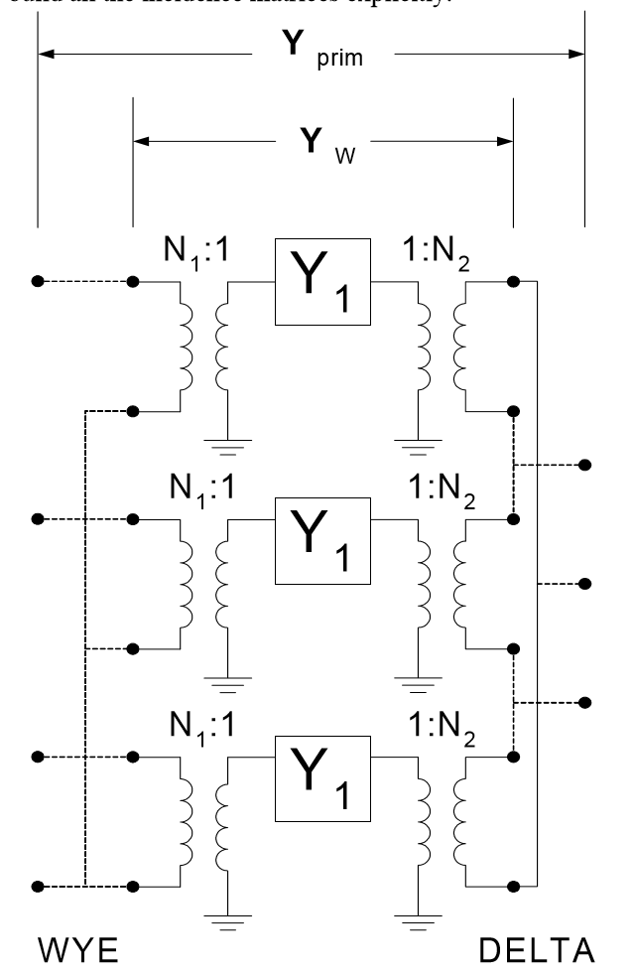
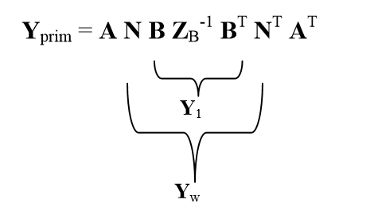
Transforming to Yprim – Wye/Delta Example

Slide 13
For a YDY Transformer, X_{SC} is a Little More Complicated

Slide 14
Effect of Core Configuration
3-Leg Core Offers Low Impedance Path to Zero Sequence
Behaves as if there is a delta-connected “Phantom” winding on the core

Slide 15
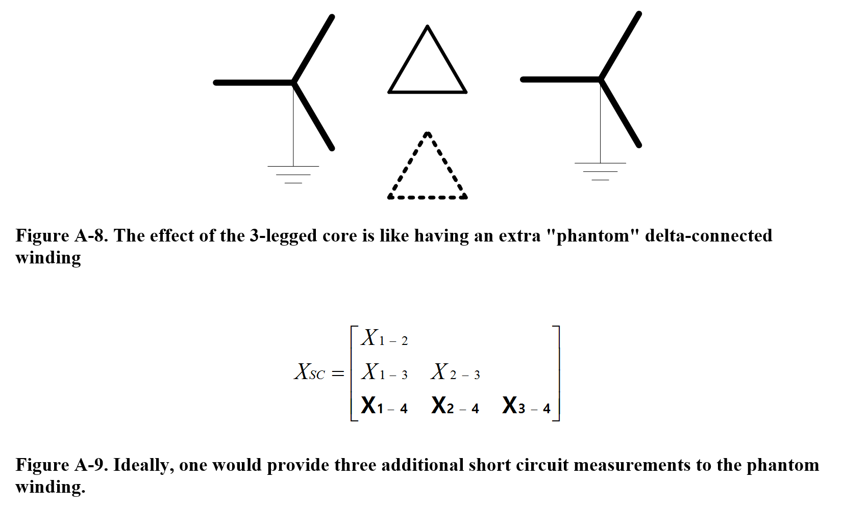
Adding The Phantom Winding

Slide 16
Transformer Data Required
Base MVA or kVA
Rated voltage: kV L-L for 3-phase transformers
Leakage Z =R+jX… usually in %
R may come from nameplate losses at rated load
Then compute X from total Z
Or, both numbers may be available in test report
Need leakage, or short circuit, Z between every pair of windings

Slide 17
Transformer Data Required
Some distribution analysis program require L-N voltage
Winding Connections
Some programs require specification of phase shift
Others compute phase shift from winding connections
E.g., Delta-wye = 30 degrees
For difficult problems in general, explicit modeling of transformer winding connections works best (using 1-phase transformers)
Zig-zag
Open-Delta
Scott T
Phase shifter

Slide 18
Dy1 or Dy11?
The ANSI standard is Dy1
LV lags the HV by 30 degrees
The standard in Europe is typically Dy11
LV leads the HV by 30 degrees
In OpenDSS Transformer model:
Default is ANSI
Dy1, Yd1
To get Dy11
Set “LeadLag=Lead” or “LeadLag=Euro”

Slide 19
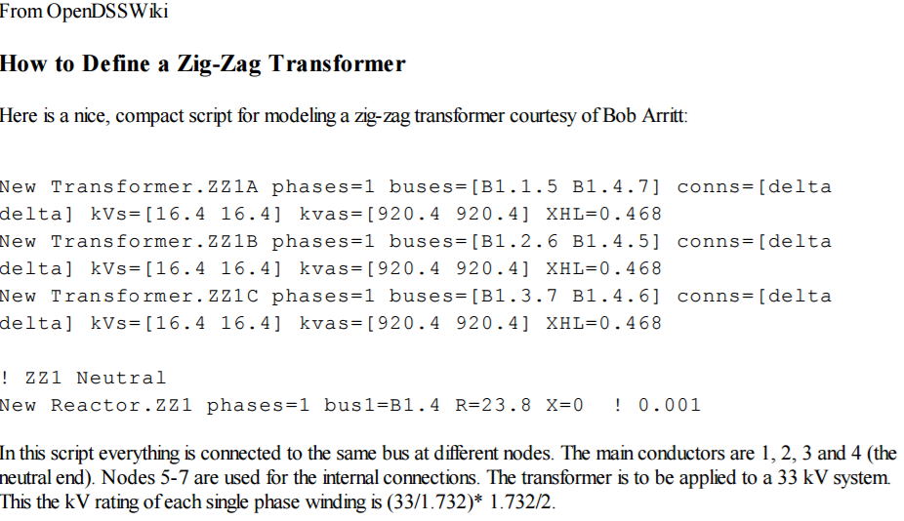
Example: Zig-Zag Transformer Script

